Slide 1

Unit-2 (Part-3)
Predicate Logic

Slide 2
Predicate Logic
Limitations of Prepositional logic
It is difficult to draw conclusions from the given facts.
Ex:- John is a boy => A
Paul is a boy => B
Peter is a boy => C
Predicate logic can represent the fact using general statements and variables can have any possible values.
In general we can write as boy(X).
boy- predicate Symbol
X- argument / variable and has {John, Paul, Peter}
When X is given its actual value then the predicate struct boy(X) becomes either true or false.
Ex:- boy(Peter)=true
boy(Mary)=false.

Slide 3
Predicate Logic
Predicate logic is an extension of propositional logic which deals with validity ,Satisfiability & Unsatisfiability of a formula along with inference rules to derive new formula.
When inference rules are added to predicate calculus ,it becomes predicate logic.
Example: “All birds fly” cannot be represented in propositional logic but can be represented in predicate logic.

Slide 4
Predicate Calculus
Term: A term is defined as either a variable, or constant or n-place function. A function is defined as a mapping that maps n terms to a single term. An n-place function is written as f(t₁, t₂….t_{n}) where t₁, t₂….t_{n} are terms.
Predicate: A predicate is defined as a relation that maps n terms to a truth value {true, false}.
Quantifiers: Quantifiers are used with variables, there are two types of quantifiers, namely, universal quantifiers, ∀(for all), and existential quantifiers, ∃ (there exists).

Slide 5
Predicate Calculus
A well-formed formula is defined as follows in predicate calculus
Atomic formula p(t₁, t₂….t_{n} ) (also called an atom) is a WFF where p is predicate symbol and t₁, t₂….t_{n} are terms.
If α and β are WFF, then ∼α , (α^β), (αѵβ), (α →β) and (α↔β) are also WFF.
If α is a WFF and X is a free variable in α, then (∀X)α , (∃X)α are also WFF. These quantifiers define the scope of the variable X.
Well formed formulae may be generated by applying the rules, a finite number of times.

Slide 6
Predicate Calculus
A well-formed formula is defined as follows in predicate calculus
Atomic formula p(t₁, t₂….t_{n} ) (also called an atom) is a WFF where p is predicate symbol and t₁, t₂….t_{n} are terms.
If α and β are WFF, then ∼α , (α^β), (αѵβ), (α →β) and (α↔β) are also WFF.
If α is a WFF and X is a free variable in α, then (∀X)α , (∃X)α are also WFF. These quantifiers define the scope of the variable X.
Well formed formulae may be generated by applying the rules, a finite number of times.

Slide 7
Predicate Logic
Examples of Predicates
French(x) → x is French → one place predicate
Speaks French(x) → x speaks French
P(x,y)=‘3x+5y=25’ → two place predicate
R(x,y,z)=‘6x²+3y²+z=21’ → two place predicate
Rides(ali,bicycle) → Ali rides a bicycle.
Two wheeled(bicycle) → A bicycle is two-wheeled.
Book(the-stranger) → The stranger is a book.
Owns( Mona, Book( The-stranger)) → Mona owns a book called The-stranger.
Teacher saw that the children were reading a book. → See(teacher, Read(children, book))

Slide 8
Predicate Logic
Examples of Predicates
All girls love music → ꓯX( Girl(X) → love(X,music))
All linguists are bald → ꓯX( linguist(X) → bald(X))
Some linguists are bald → ꓱX(linguist(X) ᴧ bald(X))
Some girls love music → ꓱX(Girl(X) ᴧ love(X,music))
No girls love music → ~X(Girl(X) ᴧ love(X,music))
Every body is happy → ꓯX( person(X) → happy(X))
John likes some animals → ꓱX( Animal(X) ᴧ likes(John,X))

Slide 9
Predicate Logic
Examples of Predicates
Nobody likes Mary
→ ~X( Person(X) → like(X, Mary))
→ ~ꓱX(Person(X) ᴧ like(X, Mary))
Some problems are difficult
→ ꓱX(Problems(X) ᴧ difficult(X))
All students that study AI are good at logic
→ ꓯX( student(X) ᴧ study AI(X)→ good at logic(X))
No student is allowed to carry mobiles
→ ꓯX( student(X) → ~carry-mobiles(X))

Slide 10
First order predicate calculus
If the quantification in predicate formula is on simple variables and not on predicates or functions, then it is called first order predicate calculus.
ꓯX, ꓯY( p(X) ↔ p(Y))
If the quantification is over predicates or functions, then it becomes second order predicate calculus.
ꓯp( p(X) ↔ p(Y))
When inference rules are added to first order predicate calculus, it becomes First Order Predicate Logic.

Slide 11
Interpretations of Formulae in FOL
Interpretation of a formulae α in FOL refers to an assignment of truth values to atoms from domain D.
Each formula α is evaluated to be true or false under a given interpretation I over a given domain D .
(ꓯX) p(X) = true if an only if p(X) = true, ∀X ∈ D otherwise it is false.
(∃X) p(X) = true if an only if ∃ c ∈ D otherwise such that p(X) = true, otherwise it is false.
Example : Evaluate the truth value of an FOL formula α : (∀X)(∃Y) p(X,Y) under the following interpretation I: D={1,2}, p(1,1)=F, p(1,2)=T, p(2,1)=T, p(2,2)=F
Solution: 1. For X=1, then ∃ 2 ∈D such that p(1,2)=T
2. For X=2, then ∃ 1 ∈D such that p(2,1)=T
Hence α is true under interpretation I.

Slide 12
Interpretations of Formulae in FOL
Example : Evaluate the truth value of an FOL formula
: (∀X)[ p(X) →,q(f(X),c) under the following interpretation I:
D={1,2}, c=1 (c is a constant from 7the domain D)
f(1) = 2, f(2) = 1, p(1) = F, p(2) = T
q(1,1) = T, q(1,2) = F, q(2,1) = T, q(2,2) = T
Solution: 1. For X=1,
p(1)→q(f(1),1) ≡ p(1)→q(2,1) = F→ q(2,1) ≡ T
2. For X=2,
p(2)→q(f(2),1) ≡ p(2)→q(1,1) = T→ q(1,1) ≡ T→ T ≡ T
Hence α is true for all values of X ∈ D under interpretation I.

Slide 13
Satisfiability and Unsatisfiability
A formula α is said to be satisfiable if and only if there exists an interpretation I such that α is evaluated to be true under I. I satisfies α
A formula α is said to be unsatisfiable if and only if ∃ no interpretation that satisfies α or ∃ no model for α.
A formula α is said to be valid if and only if for every interpretation I, α is true.
A formula α is called a logical consequence of a set of formulae {α₁, α₂…. α_{n} } if and only if for every interpretation I if α₁˄ α₂….˄α_{n} is evaluated to be true, then α is also evaluated to be true.

Slide 14
Transformation of a formula into PNF
In propositional logic the clauses are represented in CNF and DNF.
Prenex Normal Form is a notation used for obtaining the clauses from a First order Logic formula.
A formula is said to be in closed form of all the variables appearing in it are quantified and there are no free variables.
Definition: A closed formula α in FOL is said to be in PNF if and only if α is represented as (Q₁X₁) (Q₂X₂)…… (Q_{n}X_{n}) M where Q_{k} are quantifiers (∀ or ∃) X_{k} are variables, for 1≤k≤n, while M is a formula free from quantifiers.
The list of quantifiers [(Q₁X₁) (Q₂X₂)…… (Q_{n}X_{n})] is called prefix and M is called the matrix of a formula α.

Slide 15
Transformation of a formula into PNF
Conversion of Formula into PNF Notation
α - FOL formula α without a variable X.
α[X] – FOL formula α which contains a variable X
Q – Quantifier ( ∀ or ∃)
Equivalence Laws
Law 1 : (QX) α[X] * β ≡ (QX) ( α[X] * β )
Law 2 : α * (QX) β[X] ≡ (QX) ( α * β [X] )
Law 3 : ∼(∀X) α[X] ≡ (∃X) (∼α[X])
Law 4 : ∼(∃X) α[X] ≡ (∀X) (∼α[X])
Law 5 : (∀X) α[X] ˄ (∀X) β[X] ≡ (∀X) ( α[X] ˄ β[X] )
Law 6 : (∃X) α[X] ˅ (∃ X) β[X] ≡ (∃ X) ( α[X] ˅ β[X] )

Slide 16
Conversion of PNF to its standard form (Skolemization)
Prenex Normal Form of a given formula can be further transformed into a special form called Skolemization or standard form.
The process of eliminating existential quantifiers from the prefix of a PNF notation and replacing the corresponding variable by a constant or a function is called Skolemization.
The constant or function is called as Skolem constant or Skolem function.

Slide 17
Conversion of PNF to its standard form (Skolemization)
Skolemization Procedure:
Let (Q₁X₁) (Q₂X₂)…… (Q_{n}X_{n}) M be in PNF notation where (Q₁X₁) (Q₂X₂)…… (Q_{n}X_{n}) is prefix and M is matrix
Scan prefix from left to right till we obtain the first existential quantifier.
If Q₁ is the first existential quantifier then choose a new constant c ∉ {set of constants in M}. Replace all occurrence of X₁ appearing in matrix M by c and delete (Q₁X₁) from prefix to obtain new prefix and matrix.
If Q_{r} is the first existential quantifier & Q₁, Q₂… Q_{r-1} are universal quantifiers appearing before Q_{r} then choose a new (r-1) place function symbol c ∉{set of functions appearing in M}. Replace all occurrences of X_{r} in M by f(X₁ , …. X_{r-1}) and remove (Q_{r} X_{r}) from prefix.
Repeat the process till all existential quantifiers are removed from M.

Slide 18
Clauses in FOL
A clause is defined as a closed formula written in the form (L₁ ˅……˅ L_{m}) where L_{i} is a literal and the variables occurring in literals are universal quantifiers.
A formula α_{n} is said to be unsatisfiable if and only if its corresponding set S is unsatisfiable.
S is said to be unsatisfiable if and only if there ∃ no interpretation that satisfies all the clauses of S simultaneously.
S is said to be satisfiable if and only if each clause is satisfiable. i.e ∃ an interpretation that satisfies all the clauses of S simultaneously.
Alternatively, an interpretation I is said to model S if and only if I models each clause of S.

Slide 19
Resolution Refutation Method in FOL
Resolution refutation is used to test unsatisfiability of a set of clauses corresponding to the predicate formula.
L is a logical consequence of S if and only if {S ∪ ∼L} = {C₁,….. C_{m}, ∼L} is unsatisfiable. We can say that goal L is deduced from S. Here ∼L may give rise to more than one clause.
Soundness and complete of resolution refutation theorem states that there is a resolution refutation of S if and only if S is unsatisfiable. A deduction of a contradiction from a set S of clauses is called resolution refutation of S.
L is said to be a logical consequence of S if and only if there is a resolution of S ∪ {∼L}.

Slide 20
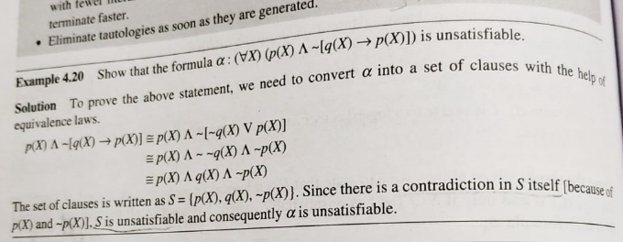
Example 3:

Slide 21
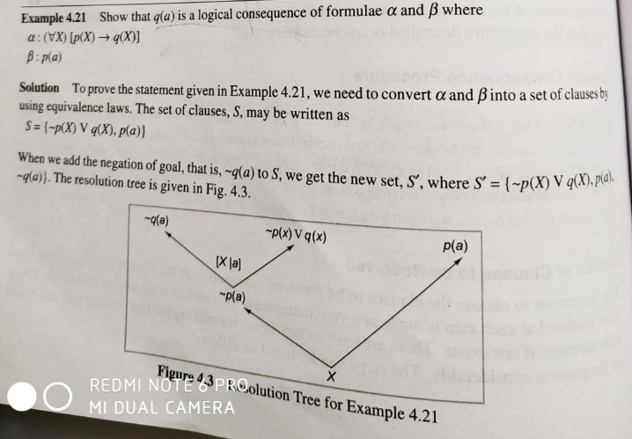
Example 4:

Slide 22
General Procedure to convert predicate logic to CNF
Eliminate all implications
Reduce the scope of all ~ to single term.
Make all variables names unique
Move Quantifiers left(PNF)
Eliminate existential Quantifiers
Eliminate Universal Quantifiers
Connect to conjunctions of disjunctions
Create separate clause for each conjunct.

Slide 23
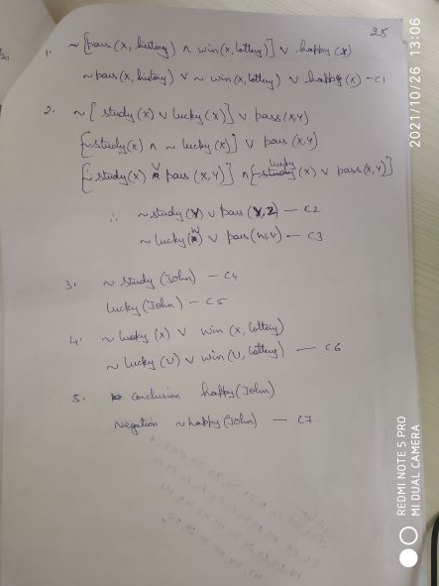
Example 8:

Slide 24
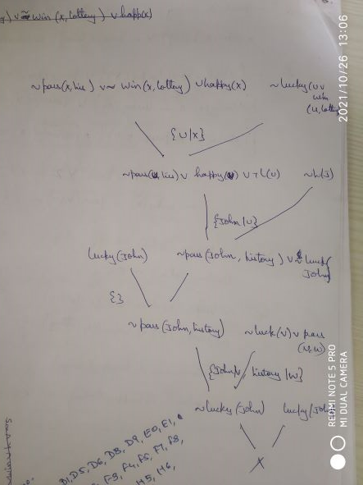
Solution to Example 8:

